Slide 1
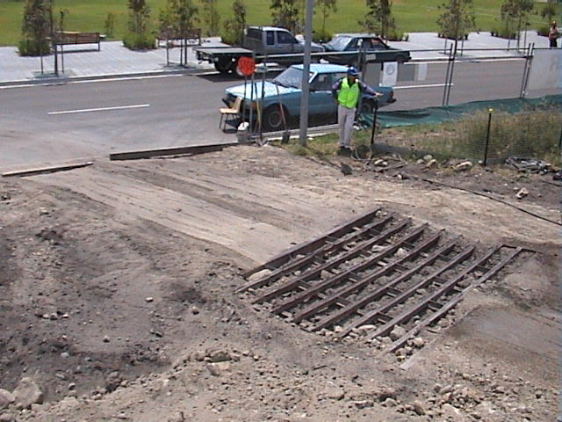
Sample Training Presentation
Claus Environmental Engineering
eclaus@ozemail.com.au

Slide 2
Saddam Hussein put a billion litres of Oil in the Persian Gulf during the 1991 Gulf War.
That doesn’t mean we can put even one Litre of oil into a stormdrain.

Slide 3
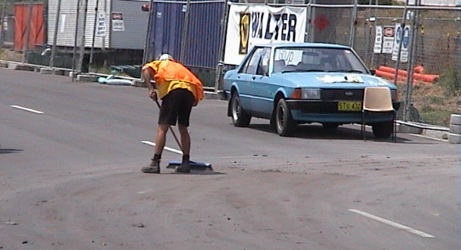
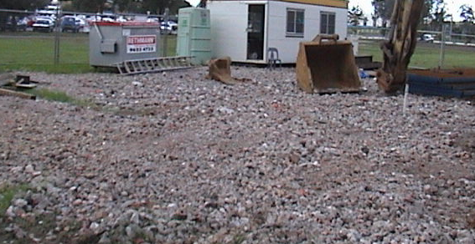
How do we keep dirt off the street?
Sweeping roads
Gravel or crushed concrete
Grates
Dirt mat

Slide 4
Silt Fences
3m maximum
Flow Direction
Buried 0.6m
Geofabric buried 100mm deep
and 150mm curled back,
250mm min buried

Slide 5
The human ear hears some frequencies better than others
Clapton
Noise energy = decibels = dB
dB(A) = “A” weighted noise level
The A weighting = human ear
Entwhistle
2000 Hz
Why are there more electric guitar solos than bass solos?
125 Hz
Notes:
Noise is measured in decibels
dB(A) means the A weighted decibel level
Why do you hear more guitar solos?
The human ear hears some frequencies better than others.
The best frequencies for the human ear are in the middle on your stereo 500, 1000 and 2000 Hz and in the high ranges up to 8000Hz.
The low ranges down to 32Hz are very hard to hear but they will carry and set up a kind of vibration. Teenager in car bass goes through the windows

Slide 6
Find Noise level at Flat A with the combined noise of the Equipment and the Truck 60 dB(A) + 62 dB(A) = ________ | Distance (m) | Noise Level dB(A) | Distance (m) | Noise Level dB(A)
 | 5 | 80 | 8 | 72
 | 10 | 74 | 16 | 66
 | 20 | 68 | 32 | 60
 | 40 | 62
64

